Slide 1
CNN Model for Self-Driving cars
By: Yadnyshree Savant

Slide 2
State-of-Art
Need data from Human driving.
Detects on roads with proper lane markings.
Machine cannot learn by itself.

Slide 3
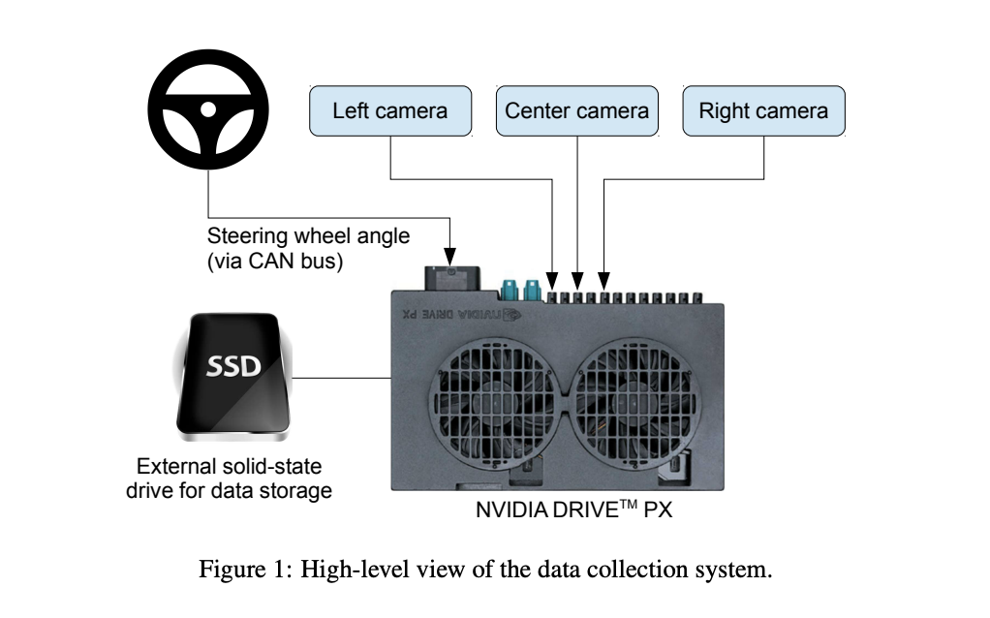
Overview of the DAVE-2 System

Slide 4
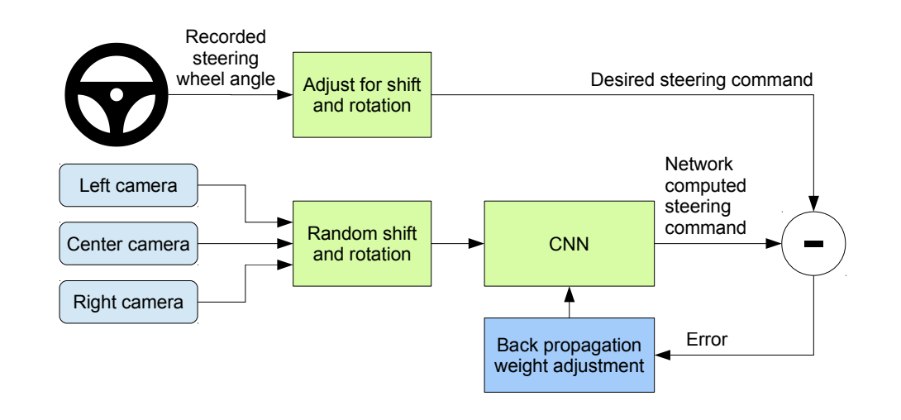
Training the Neural network

Slide 5
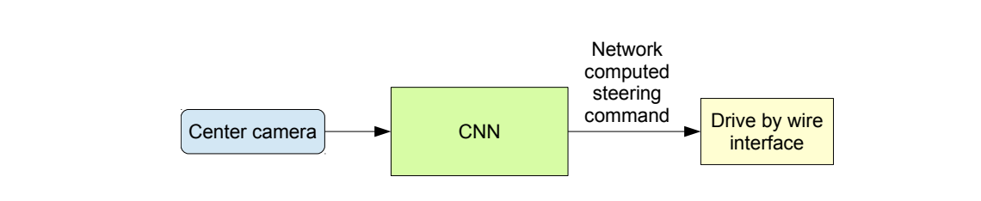
Trained Model

Slide 6
Data Collection
Data collected on variety of roads.
Forest.
Under various weather conditions.
Plain roads with or without lane markings.
Residential areas, tunnels

Slide 7
Architecture
Nine Layers
1 Normalization Layer : Image Normalization.
5 Convolutional layers: Feature Extraction.
3 fully connected layers: Controller for the steering.

Slide 8
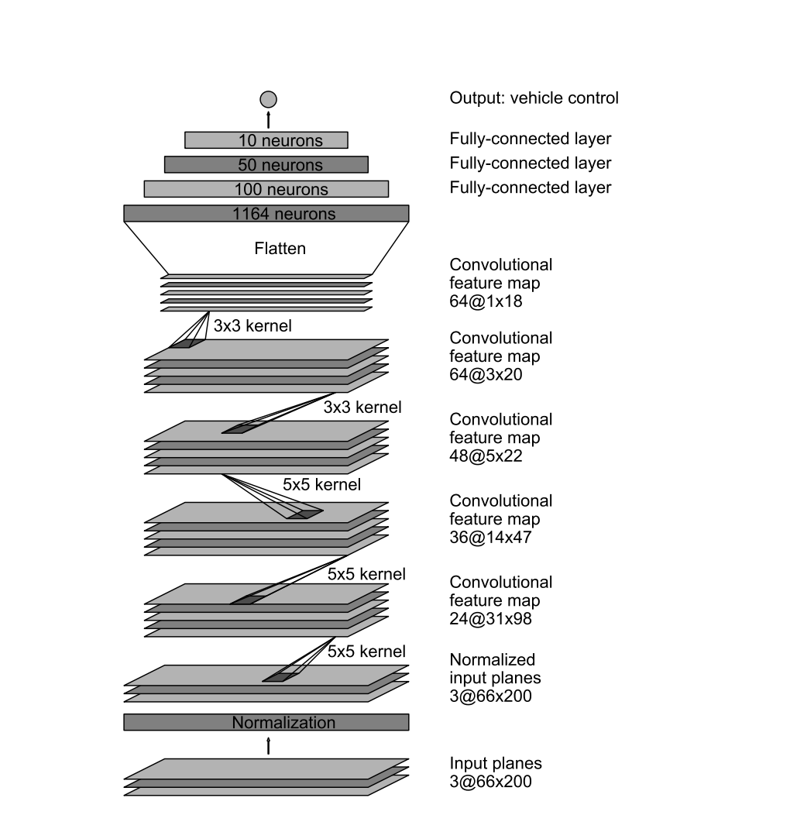
Architecture

Slide 9
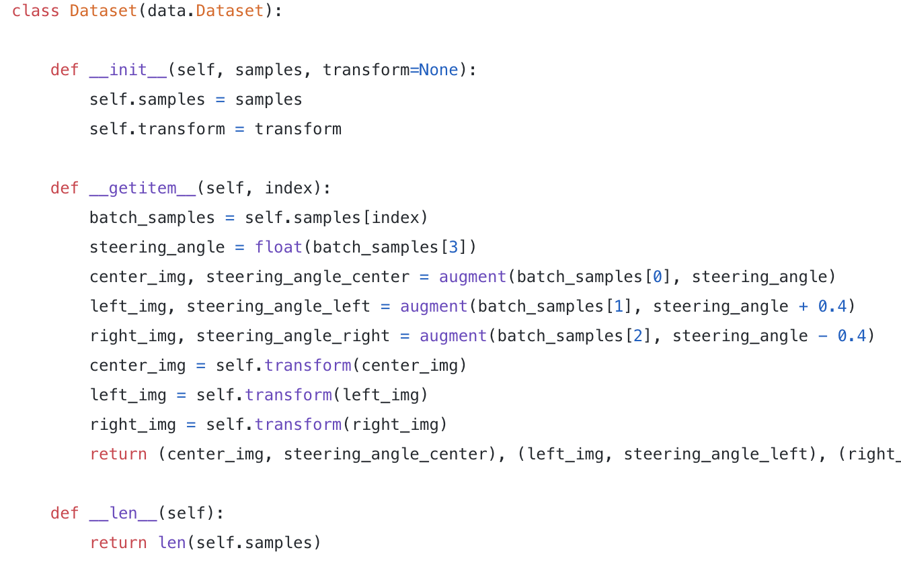
Data Augmentation
Data is augmented so that the system learns from itself.

Slide 10
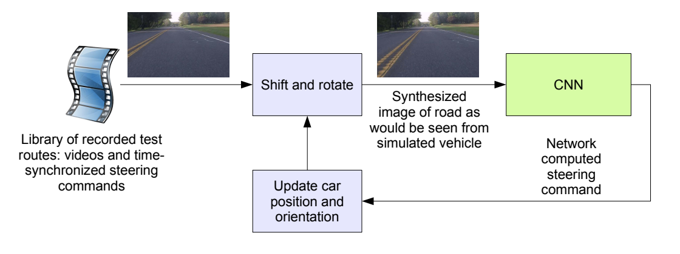
Testing using simulator

Slide 11
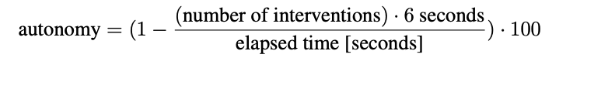
Simulation Tests

Slide 12
Conclusion
CNN learn without human intervention.
Less amount of data is sufficient.
Model can self learn.

Slide 13
References
https://arxiv.org/pdf/1604.07316v1.pdf
https://towardsdatascience.com/deep-learning-for-self-driving-cars-7f198ef4cfa2

Slide 14
Thank You

